Slide 1
Machine Learning Basics
Anand Rajaraman

Slide 2
London Cholera Outbreak, 1854
Mackenzie, J. 2010. Mapping the 1854 London Cholera Outbreak

Slide 3
John Snow’s Analysis
Mackenzie, J. 2010. Mapping the 1854 London Cholera Outbreak

Slide 4
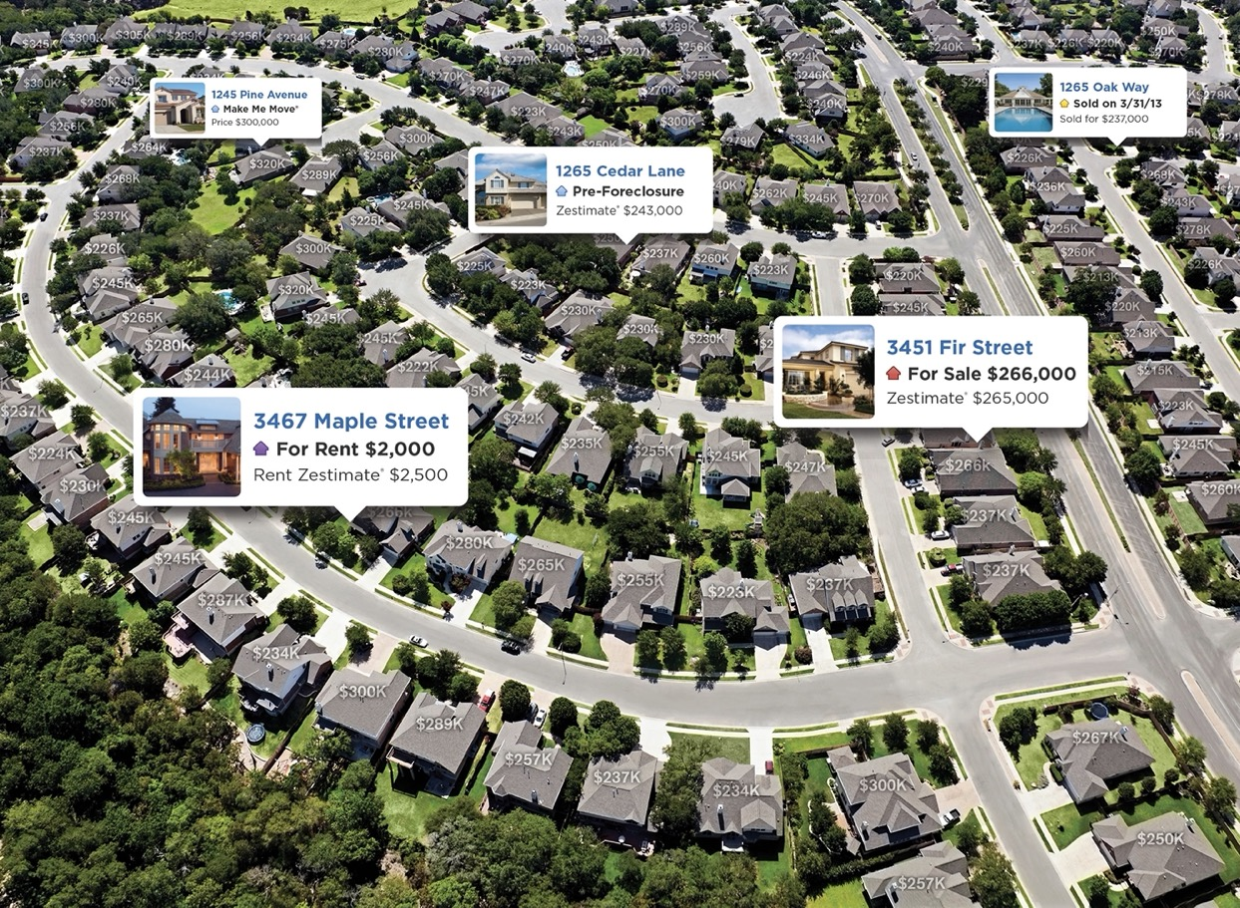
Zestimates

Slide 5
Predicting Home Prices
Zipcode
Lot Size
Square footage
Model
Estimated
Value
YearBuilt
Features
Last Price
Garage Capacity
The model is trained using data from actual home sales

Slide 6
Machine Learning and Data Mining
Data Mining: Find patterns in a dataset
Often just a high-level idea of what we’re looking for
Also known as: Unsupervised Learning
Machine Learning: Get better at a well-specified task based on experience (i.e., training)
Also known as: Supervised Learning
Notes:
Perhaps you will make it clear when giving the lecture, but I don’t yet feel that I know ‘why’ there is a distinction between supervised and unsupervised. The general distinction helps mostly for data scientists, but most other disciplines are less clear about the distinction. You could say that unsupervised learning is an ‘exploratory’ practice, focused on ‘unknown unknowns’ whereas supervised is more about solving known problems by analyzing the answers to previous problems. Something of that nature would help this slide bridge beyond data science.

Slide 7
Supervised Learning

Slide 8
Predicting Home Prices

Slide 9
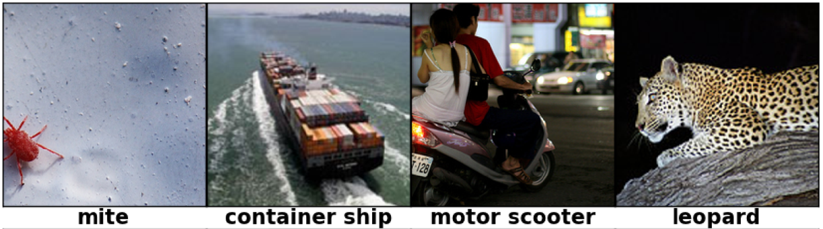
Identifying Image Subject

Slide 10
Regression and Classification
Regression: predict a numeric value
Classification: predict a “class label”
Pick a label from a pre-determined set of labels
Labels might be organized hierarchically
Most ML algorithms can be adapted for both regression and classification

Slide 11
Design Criteria: Choosing an ML algorithm
Feature Availability
How important is feature engineering?
Accuracy
How good are the model’s predictions?
Interpretability
How easy is it to for people to understand the reason for the model’s predictions?

Slide 12

Predicting Home Prices
Feature Availability
Accuracy
Interpretability

Slide 13

Identifying Image Subject
Feature Availability
Accuracy
Interpretability

Slide 14
FB Suicide Risk Prediction
code.fb.com

Slide 15
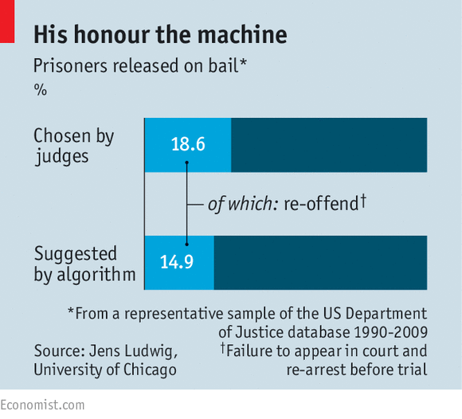
Making Bail Decisions
The Economist, August 20, 2016

Slide 16

Product Recommendations

Slide 17
Linear Regression
Can be generalized to many features
Output is predicted to be a simple weighted sum of features
Penn State. Stats 501

Slide 18
Linear Regression
Feature Availability
Feature engineering is critical to success
Accuracy
Modest, scales with number of features and data
Interpretability
High – can understand the contribution of each feature
Excellent baseline model
Often the first thing to try before anything more complex
Can also be used for classification (e.g., logistic regression)

Slide 19
Decision Trees
Trees are good, but
forests are better!
Ensembles of many trees
e.g., Random forests,
Gradient Boosted Trees
Machine Learning at Berkeley

Slide 20
Random Forest
Each tree uses a random subset of features and trained on random subset of data
Example: Loan origination
William Koehrson, Medium

Slide 21
Decision Trees
Feature Availability
Depends on features being available
Accuracy
High potential accuracy, especially with ensembles
Accuracy scales with number of features
Interpretability
Single tree: high
Random Forest: modest
“Sweet spot” for many use cases
Loan origination
Customer churn prediction
Fraud detection

Slide 22
Collaborative Filtering
How to determine whether two user (or items) are similar?
Purchases, views, ratings, …
Special case of: Near Neighbor methods

Slide 23
Sparse Rating Matrix
Users
 | U1 | U2 | U3 | U4 | U5 | U6 | U7 | U8 | U9
M1 |  | 1 |  |  | 4
M2 | 3 |  |  |  |  |  | 2
M3 |  | 4 |  |  |  |  | 3
M4 |  |  |  | 5 |  |  |  |  | 1
M5
M6 | 5 |  | 4 | 3 |  | 5 |  | 4
M7 |  |  |  | 2
M8 |  |  |  |  | 5 |  |  | 4
Movies
Typical user has rated less than 1% of items, and likewise for items
Hard to be confident about “similar users” or “similar items”
Popular items are most often rated, but usually the least informative

Slide 24
Dimensionality Reduction
Infer ratings on higher-level units such as genre
Sci-fi: 5
Sci-fi: 5
Sci-fi: 5
Horror: 1
Horror: 1
Horror: 0
Romance: 3
Romance: 2
Romance: 2
Action: 4
Action: 5
Action: 5
Users
 | U1 | U2 | U3 | U4 | U5 | U6 | U7 | U8 | U9
G1 | 1 | 1 | 2 | 3 | 4 | 4 | 1 | 5 | 1
G2 | 3 | 5 | 3 | 5 | 5 |  | 2 | 4 | 5
G3 | 5 | 4 | 4 |  | 2 |  | 3 | 3 | 1
G4 | 2 | 1 | 5 | 5 | 1 | 5 | 5 | 1 | 1
Sci-fi
Genres
Horror
Romance
Action

Slide 25
Genre-based dimensionality reduction
Unfortunately, doesn’t work so well in practice

Slide 26
Matrix decomposition
Use some fancy math to “embed” users and items in lower-dimensional space
Works much better
But new dimensions are not easily interpretable
D1: 0.19
D1: 0.25
D1: 0.20
D2: -0.81
D2: -0.7
D2: -0.75
D3: 0.33
D3: 0.21
D3: 0.27
D4: -0.42
D4: -0.61
D4: -0.51

Slide 27
Collaborative Filtering
Feature Availability
No features needed except for user/item ratings!
Accuracy
High with matrix decomposition
Modest without
Interpretability
Low with matrix decomposition
High without

Slide 28

Deep Learning
Feature Availability
Can find its own features!
Accuracy
Very high, scales with data
Interpretability
Low (ongoing research to improve)

Slide 29
Design choices landscape
Linear
Regression
Decision
Trees
Interpretability
Random
Forest
Collab
Filtering
Deep
Learning
Accuracy

Slide 30
Picking the Operating Point
Each ML algorithm comes with many knobs and dials
Aka parameters
Leads to important design choices
Let’s look at an example: how to measure accuracy

Slide 31
Accuracy
Accuracy = Fraction of predictions that are accurate
Consider a test for a disease that affects 1% of people (binary classifier)
An algorithm that always predicts “No” is 99% accurate!

Slide 32
Positives and Negatives
True Positive
True Negative
False Negative
False Positive
Key measures: True Positive Rate, False Positive Rate

Slide 33
Confusion Matrix
Actual Value
+
-
Predicted Value
+
TP
FP
-
FN
TN
True Positive Rate = TP/(TP+FN)
False Positive Rate = FP/(TP+FP)

Slide 34
ROC Curve
100%
True
Positive
Rate
0
0
False
Positive
Rate
100%

Slide 35
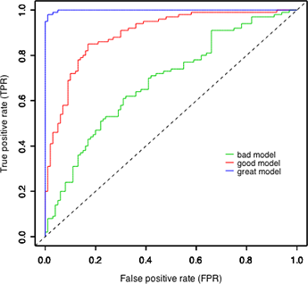
Comparing models

Slide 36
Unsupervised Learning

Slide 37
Methods
Clustering
Finding groups of similar entities
Association Rules
Beer and Diapers
Graph Analysis
Page Rank – measuring popularity
Graph clustering – finding communities
Time Series Modeling
Understanding seasonality

Slide 38
Clustering
Imperva.com blog

Slide 39
Clustering: Design Choices
Distance Measure
Determining how similar (or different) data points are
Feature Scaling
Dealing with very different features
Number of clusters
How to pick a good number?

Slide 40
Distance: London Cholera Example
Mackenzie, J. 2010. Mapping the 1854 London Cholera Outbreak

Slide 41
Geographic Data
Manhattan distance
Euclidean distance
The choice of distance metric depends on the application
Euclidean (L2)
Manhattan (L1)
Driving time

Slide 42
Media consumption
Suppose we record the number of hours each user watched each channel
Cluster viewers by media consumption

Slide 43
Just focus on two channels for now…
Euclidean distance
Cosine distance

Slide 44
DNA sequences
ATGTCGTATGC
Delete T (position 2), insert A (position 5)
Edit distance = 2
AGTCAGTATGC
Edit distance is often useful for sequences
DNA
Amino Acids
Genes

Slide 45
Feature Scaling: Document Clustering
Jaguar

Slide 46
Words as features
Document A
Document B
Word | Mentions
the | 8
put | 3
… | …
torque | 1
driver | 1
Word | Mentions
the | 7
put | 4
… | …
feline | 1
habitat | 1
How similar are these two documents?
Idea: give less common words more weight than more common words
Technical term: TF.IDF

Slide 47
Height and Weight
Shaquille
O’Neal
7’1’’, 325lb
Height
(meters)
6’8’’, 250lb
2
6’0’’, 326lb
LeBron
James
1
Asashōryū Akinori
200
250
Weight (lbs)
300
How to put height and weight on comparable scales?
Percentile
z-score

Slide 48
Clustering Quality
Cohesion
Separation
The Cluster Silhouette combines these into a single measure

Slide 49
Choosing number of clusters
Cohesion
Number of clusters
The Elbow Method

Slide 50
Hierarchical Clustering: Dendrogram
Distance
Observations

Slide 51
Extra slides

Slide 52
Matrix Decomposition
 | D1 | D2 | D3 | D4
M1 | 0.1 | 1 | -0.4 | 0.6
M2 | -0.4 | 0.5 | 0.3 | -0.5
M3 | -0.8 | 0.2 | 0.2 | 0.4
M4 | 0.2 | -0.5 | 0.1 | -0.3
M5 | 0.7 | 0.9 | 0 | 0.2
M6 | -0.1 | 0.1 | 0.9 | -0.1
M7 | 0.5 | -0.9 | -0.8 | 0
M8 | 0.3 | 0.4 | 0.7 | 0.5
 | U1 | U2 | U3 | U4 | U5 | U6 | U7 | U8 | U9
M1 |  | 1 |  |  | 4
M2 | 3 |  |  |  |  |  | 2
M3 |  | 4 |  |  |  |  | 3
M4 |  |  |  | 5 |  |  |  |  | 1
M5
M6 | 5 |  | 4 | 3 |  | 5 |  | 4
M7 |  |  |  | 2
M8 |  |  |  |  | 5 |  |  | 4
 | U1 | U2 | U3 | U4 | U5 | U6 | U7 | U8 | U9
D1 | 0.6 | -0.5 | 0.4 | -0.3 | 0.2 | 0 | 0.1 | -0.3 | 0.5
D2 | 0.3 | -0.2 | 0 | 0.2 | 0.4 | -0.6 | 0.7 | 0.9 | 1
D3 | -0.5 | 0.1 | -0.1 | 0.2 | 0.3 | 0.5 | 0.7 | -0.9 | 1
D4 | 0.2 | 0.3 | 0.5 | -0.7 | -0.1 | -0.3 | -0.7 | -0.9 | 0.3
Decompose rating matrix into lower-dimensional matrices
Ignore the math
Works much better!
“Similar” users have “similar” columns
But new matrices are not super-interpretable

